Slide 1
Full-speed Fuzzing: Reducing Fuzzing Overhead through Coverage-guided Tracing
Stefan Nagy Virginia Tech snagy2@vt.edu
Matthew Hicks Virginia Tech mdhicks2@vt.edu
40th IEEE Symposium on Security and Privacy
MAY 20-22, 2019 AT THE HYATT REGENCY, SAN FRANCISCO, CA
@zjt 2019.11

Slide 2
Re-cap: Algorithm of coverage-guided fuzzing (AFL)

Slide 3
Re-cap: Algorithm of coverage-guided fuzzing
Input generation
Mutation-based
Concolic-execution
…
Execution
Fork-server
Parallel
validateXml(xmlStr); // <xml>fuzzable</xml>
if (str == “magicvalue”) { … }

Slide 4
Re-cap: Algorithm of coverage-guided fuzzing
Input generation
Mutation-based
Concolic-execution
…
Execution
Fork-server
Parallel
Notes:
避免重复的程序初始化工作
动态链接、库初始化，占用大量执行时间
但实际上只有在读取输入之后的代码才会影响 coverage
从程序初始化完成的点 clone 自身

Slide 5
Tracing
Black-box: binary-only instrumentation (QEMU)
White-box: compile-time instrumentation
foo() {
int a = 1;
foo1();
if (a == 1) {
foo2();
} else {
foo3();
}
foo4();
}
Basic block

Slide 6
Instrumentation
// block start
cur_location = <COMPILE_TIME_RANDOM>;
shared_mem[cur_location ^ prev_location]++;
prev_location = cur_location >> 1;
// block content
// …

Slide 7
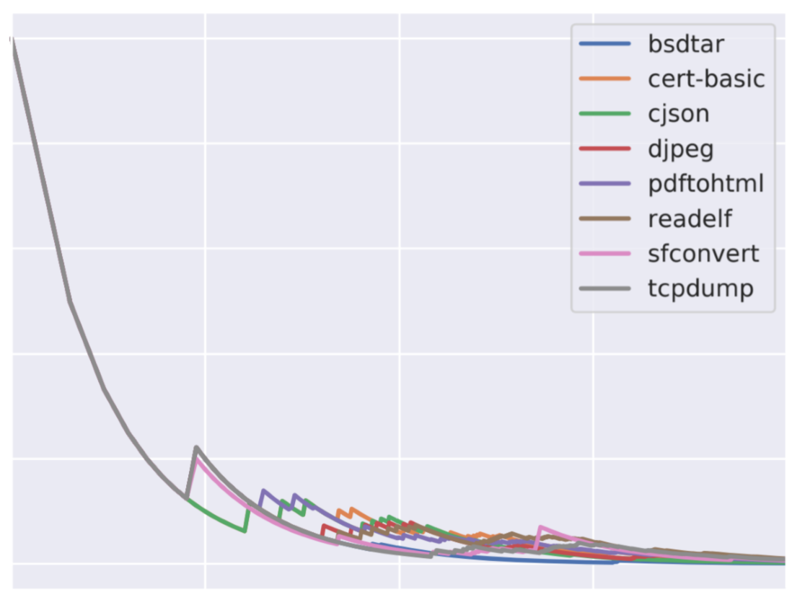
Fuzzing Overhead Evaluation
Observation 1: > 90% time on execution/tracing
Observation 2: < 3/10000 test cases increase coverage
Observation 3: rate decrease overtime

Slide 8
Fuzzing Overhead Evaluation

Slide 9
Coverage-Guided Tracing
The fuzzer let the program run at full-speed (no-tracing)
For a case that triggers new coverage, the program report it to fuzzer
The fuzzer trace this case only
The fuzzer tell the program not to report about these new coverage

Slide 10
Coverage-Guided Tracing

Slide 11
Coverage-Guided Tracing
Normal exec
Block 1
Block 2
Block 3
Block n
Execution
Execution
Execution
...
Execution
Block 1
Block 2
Block n
Tracing every block
Tracing
Execution
Tracing
Execution
...
Tracing
Execution
Coverage-Guide Tracing
(non-coverage-increase)
99.97%
block
block
block
block
Execution
Execution
Execution
...
Execution
Coverage-Guide Tracing
(coverage-increase)
0.03%
block
block
Block 1
Block 2
Block n
Execution
Execution
Tracing
Execution
Tracing
Execution
...
Tracing
Execution

Slide 12
Implementation
Two versions of binary:
Interest oracle
Tracer
SIGTRAP

Slide 13
Oracle
Tracer
Implementation
Start two fork-servers
Execute on interest oracle
Trace interesting test cases
Stop oracle fork-server
Unmodify (remove interrupts)
Restart fork-server
Unmodify

Slide 14
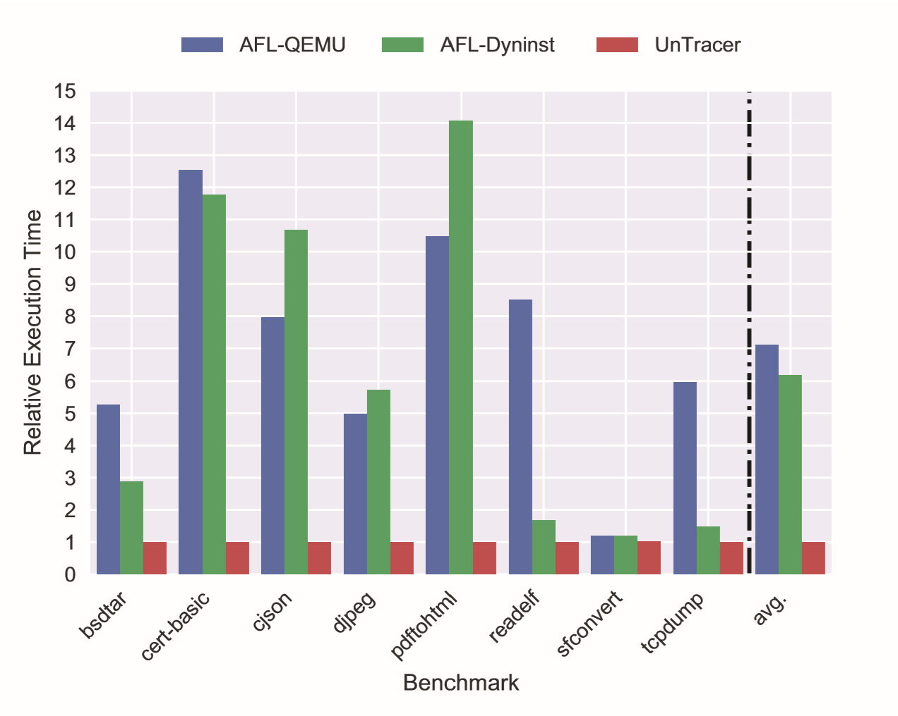
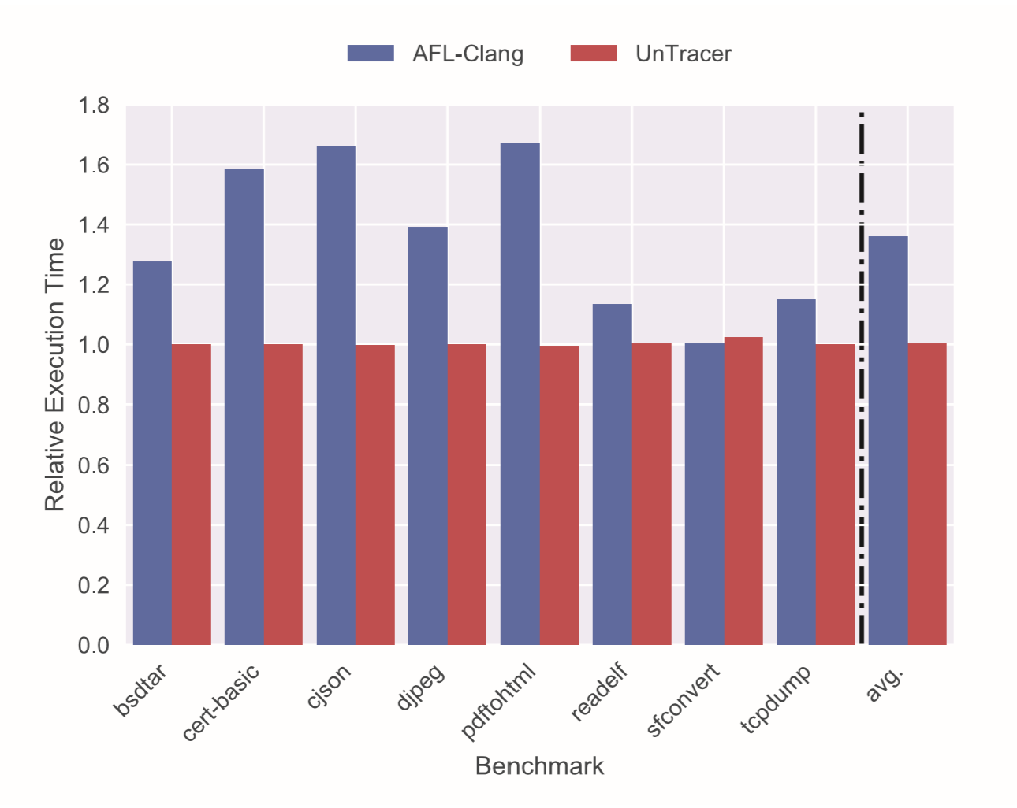
Evaluation
612% / 518% / 0.3%
36% / 0.3%

Slide 15
Conclusion
Fuzzers find coverage-increasing test cases by tracing all of them
Costs over 90% of time yet over 99.99% are inevitably discarded
The resource could be used to find bugs
Cut tracing overhead from 36%-618% to 0.3%

Slide 16
Full-speed Fuzzing: Reducing Fuzzing Overhead through Coverage-guided Tracing
Thanks.

